Slide 1

Branch - CSE Python Programming
Lecture – 22 Sets – Part 1
By
Dr. Smita Tiwari
Assistant Professor
Department of Computer Science and Engineering
School of Engineering & Technology

Slide 2
Python Set
A set is an unordered collection of items.
Every set element is unique (no duplicates) and must be immutable (cannot be changed).
However, a set itself is mutable. We can add or remove items from it.
Sets can also be used to perform mathematical set operations like union, intersection, symmetric difference, etc.

Slide 3
Creating Python Sets
A set is created by placing all the items (elements) inside curly braces { }, separated by comma, or by using the built-in set() function.
It can have any no. of items and they may be of different types (integer, float, tuple, string, etc.).
But a set cannot have mutable elements like lists, sets or dictionaries as its elements.

Slide 4
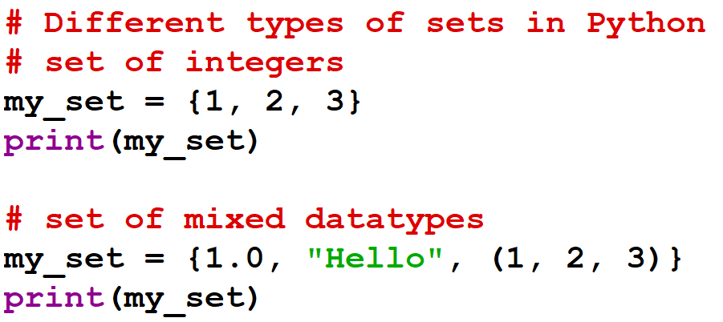
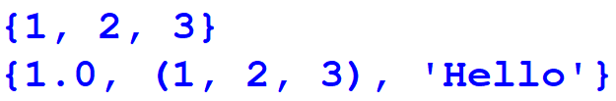
Output:

Slide 5
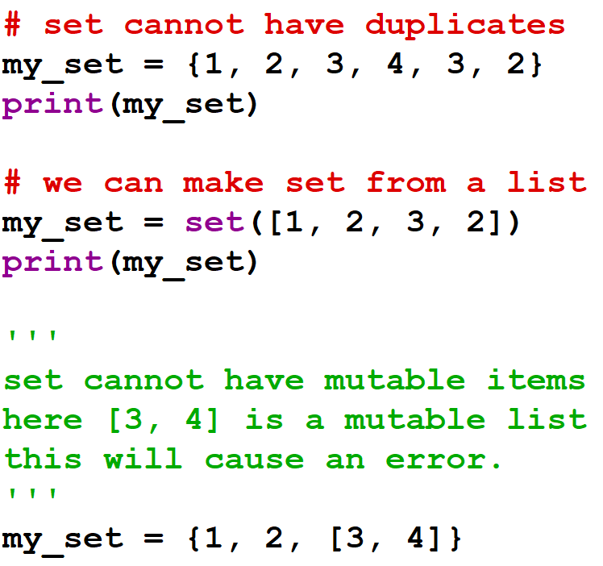
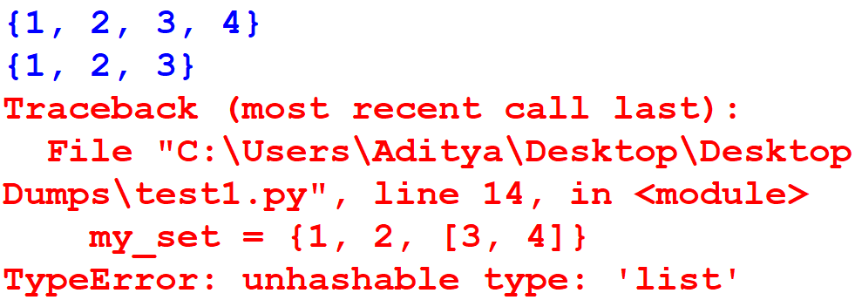
Output:

Slide 6
Creating Python Sets
Creating an empty set is a bit precarious (tricky).
Empty curly braces { } will make an empty dictionary in Python.
To make a set without any elements, we use the set() function without any argument.

Slide 7
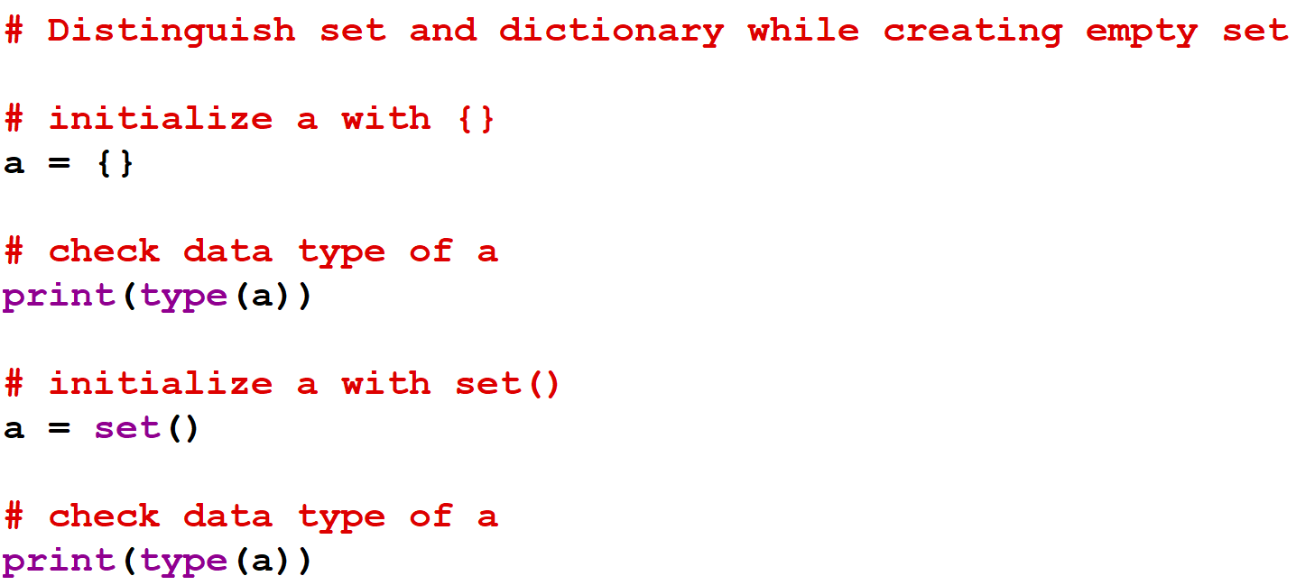
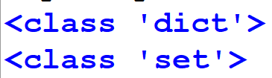
Output:

Slide 8
Modifying a set in Python
Sets are mutable.
However, since they are unordered, indexing has no meaning.
We cannot access or change an element of a set using indexing or slicing.
Set data type does not support it.

Slide 9
Modifying a set in Python
We can add a single element using the add() method, and multiple elements using the update() method.
The update() method can take tuples, lists, strings or other sets as its argument.
In all cases, duplicates are avoided.

Slide 10
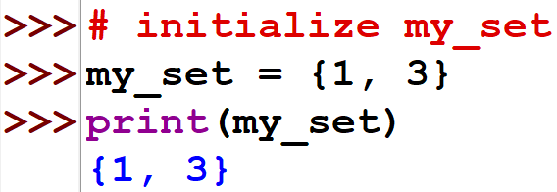
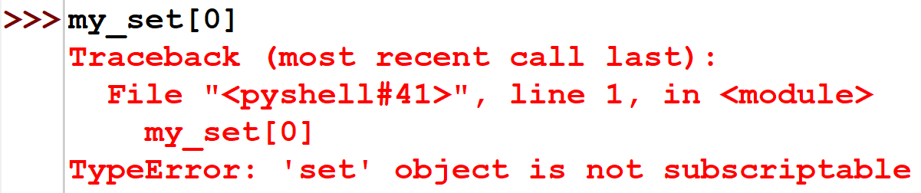
Modifying a set in Python

Slide 11
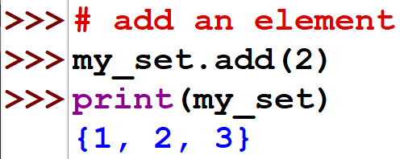
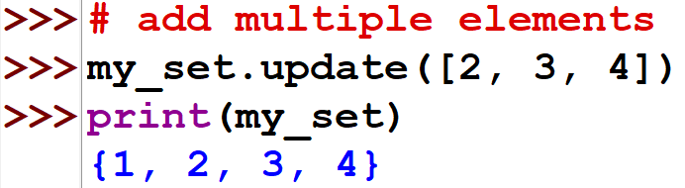
Modifying a set in Python

Slide 12
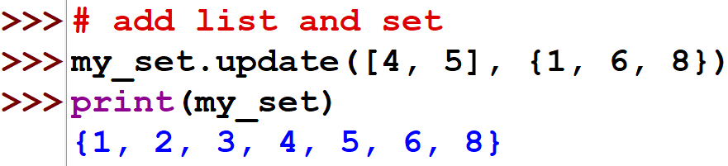
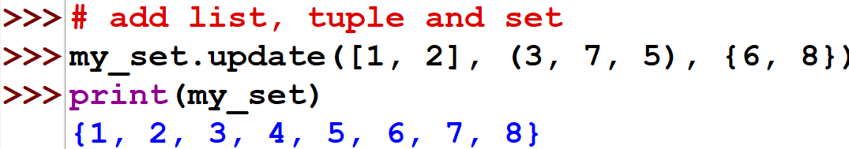
Modifying a set in Python

Slide 13
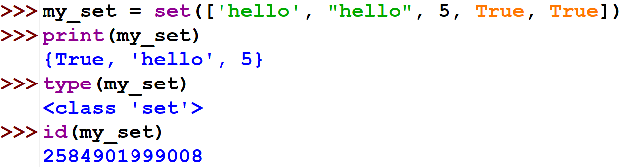
Example

Slide 14
Frozen Sets
The frozenset() function returns an immutable frozenset object initialized with elements from the given Iterable.
Frozen set is just an immutable version of a Python set object. While elements of a set can be modified at any time, elements of the frozen set remain the same after creation.
Due to this, frozen sets can be used as keys in Dictionary or as elements of another set. But like sets, it is unordered (the elements can be set at any index).

Slide 15
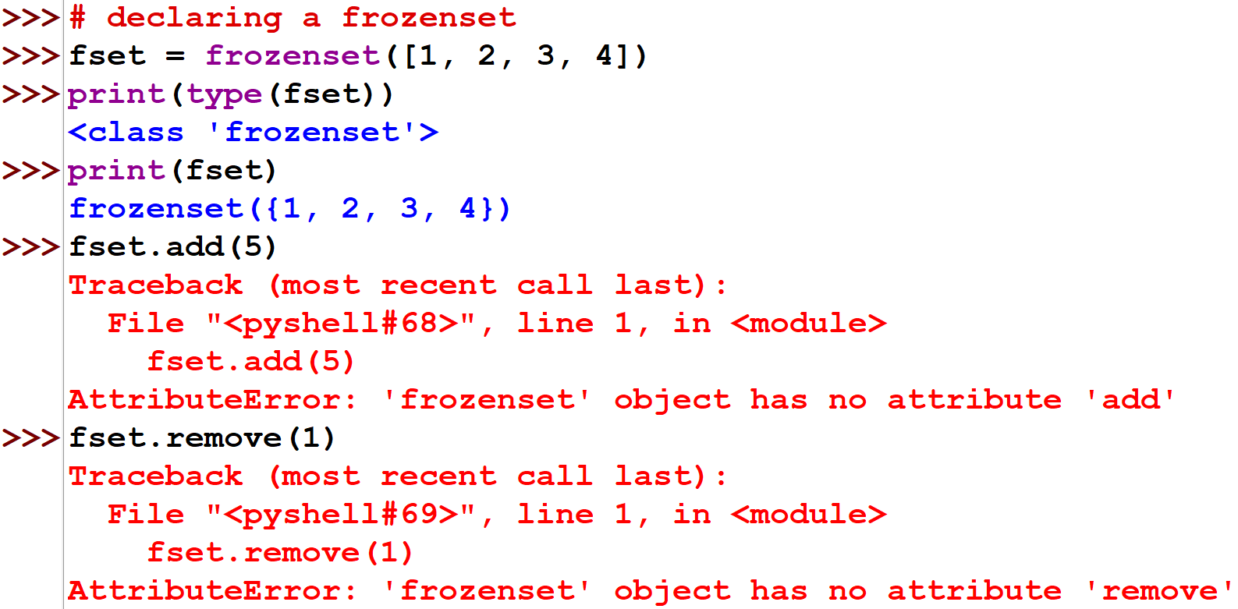
Frozen Sets

Slide 16
THANK YOU

